Slide 1
Linux Desktop Environments (KDE & GNOME), Application Software & System Software
By:
Shahina Anwarul
sanwarul@ddn.upes.ac.in

Slide 2
Desktop Environment ?
Desktop environment is an implementation of the desktop interface made of a bundle of programs running on top of a computer OS.

Slide 3


Linux Desktop Environments
Four of the most popular desktop environments in Linux are GNOME, KDE, Xfce, and LXDE. All four offer sophisticated point-and-click graphical user interfaces (GUIs).
Which is best ?
It is largely a matter of opinion. Plus, the capabilities of your computer hardware can also be important in deciding.
For example, users with older computers will be better served to choose Xfce or LXDE, while users with newer hardware can get more desktop effects by choosing GNOME or KDE. GNOME, KDE, Xfce, and LXDE are all excellent, and to varying degrees, each can be customized in a number of ways.

Slide 4

KDE (K Desktop Environment)
Desktop environment in Linux.
Is very similar in appearance to Microsoft Windows.
Developed in 1996 by Matthias Ettrich.
KDE includes a large number of applications which are designed to be used in its desktop, many of which have a name that begins with the letter "K.“
For example, Konqueror is the default web browser.
KStars is a desktop planetarium.
Kubuntu is the KDE version of Ubuntu.
Dolphin is the default file manager.

Slide 5
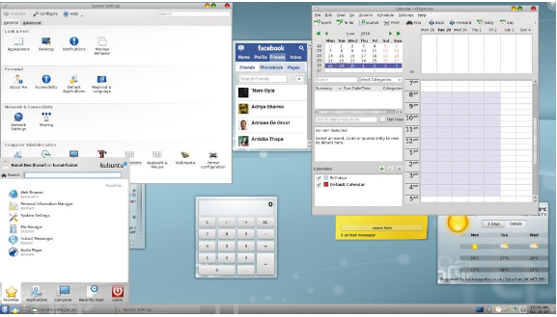
Typical KDE Environment

Slide 6
Aim of the KDE Project
Aim of the KDE Project is:
To provide Unix-like systems with a user-friendly environment that was, at the same time, open, stable, trustworthy and powerful.
To create a series of applications that would allow the user to achieve their objectives effectively and efficiently.

Slide 7
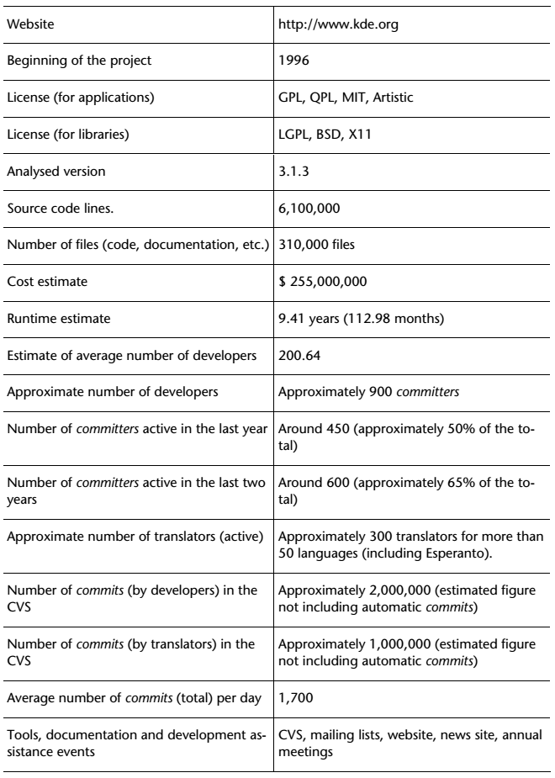
Summary of KDE

Slide 8
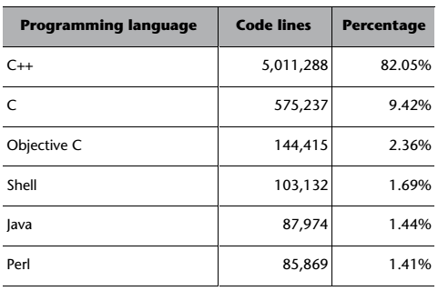
Programming Languages used in KDE

Slide 9

GNOME (GNU Network Object Model Environment)
Desktop environment in Linux.
Started on september 1997 by Miguel de Icaza and Federico Mena as a free software project to develop a desktop environment and applications for it.
GNOME itself is licensed under the LGPL for its libraries, and the GNU General Public License (GPL) for its applications.
The main objective of the GNOME project is to create a desktop system for the user that is complete, free and easy to use.

Slide 10
GNOME (GNU Network Object Model Environment)
It has 3 versions:
GNOME 2.x
GNOME 3
Unity

Slide 11
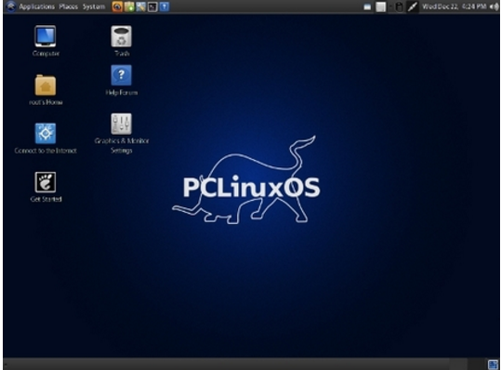
GNOME 2.x

Slide 12
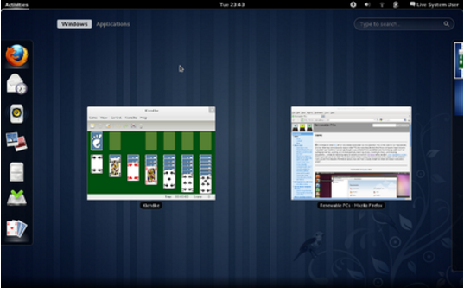
GNOME 3

Slide 13
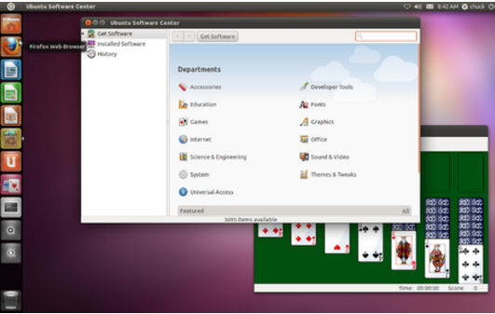
Unity

Slide 14
The GNOME Foundation
The GNOME Foundation was created in 2000; its headquarters are situated in Boston, US.
The GNOME Foundation is divided into two large committees:
A managing committee
An advising committee

Slide 15
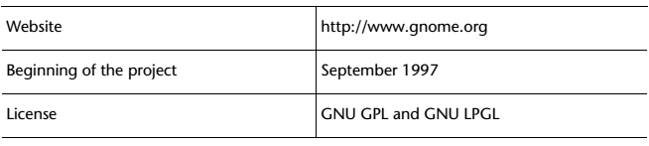
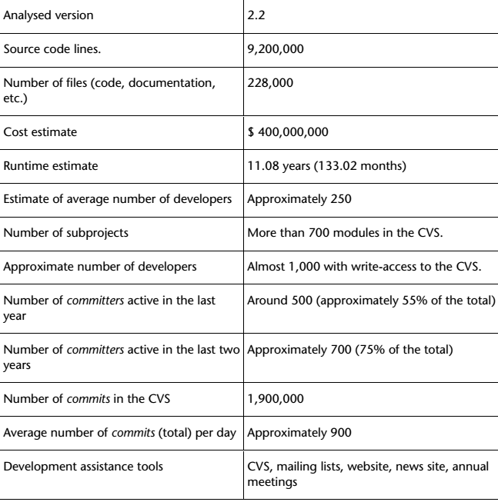
Summary of GNOME

Slide 16
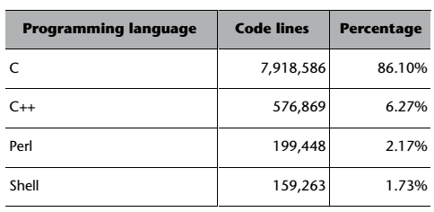

Programming Languages Used in GNOME

Slide 17
System Software
System Software have direct control and access to your computer hardware , and memory locations . They perform I/O operations on various memory locations , and control the hardware , to make the application software to do a specific task.
Operating systems are the main examples for system software.
Microsoft Windows
Linux
Unix
Mac OSX
DOS

Slide 18
Application Software
Application software run under System Software and are designed to perform a group of coordinated functions, tasks, or activities for the benefit of the user.
Examples:
Opera (Web Browser)
Microsoft Word (Word Processing)
Microsoft Excel (Spreadsheet software)
MySQL (Database Software)
Microsoft Powerpoint (Presentation Software)
iTunes (Music / Sound Software)

Slide 19
Difference between Application Software & System Software
System software gets installed when the operating system is installed on the computer while application software is installed according to the requirements of the user.
System software includes programs such as compilers, debuggers, drivers while application software includes media players, word processors, and spreadsheet programs.
Generally, users do not interact with system software as it works in the background whereas users interact with application software while doing different activities.
A computer may not require more than one type of system software while there may be a number of application software programs installed on the computer at the same time.
System software can run independently of the application software while application software cannot run without the presence of the system software.

